Slide 1
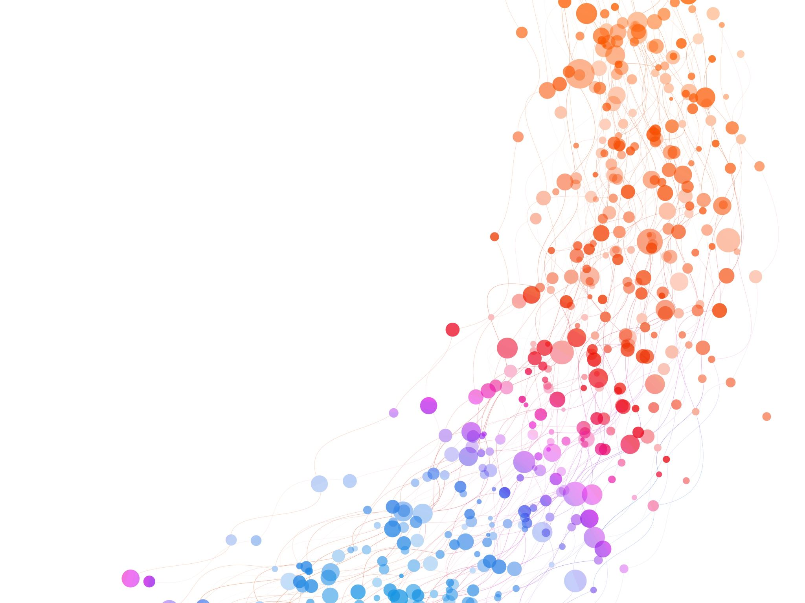
Live Changepoint Detection & Portfolio Rebalancing
Angela Zhao
Presentation for Probability Theory IV

Slide 2
“Time in the market beats timing the market” It’s a submartingale!

Slide 3
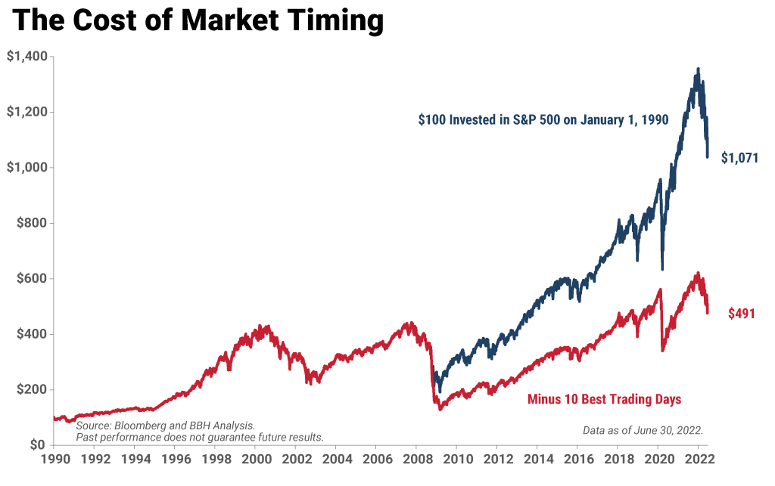
“Time in the market beats timing the market” It’s a submartingale!

Slide 4
“Time in the market beats timing the market”
Not true!
The best days follow the worst days. If you miss the 10 worst days, you will be up 70% .

Slide 5
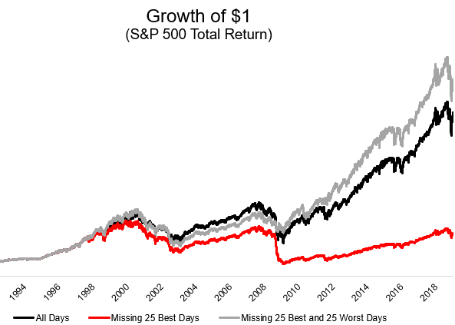
“Time in the market beats timing the market”

Slide 6

When should we readjust?
Mean returns down
Volatility up

Slide 7
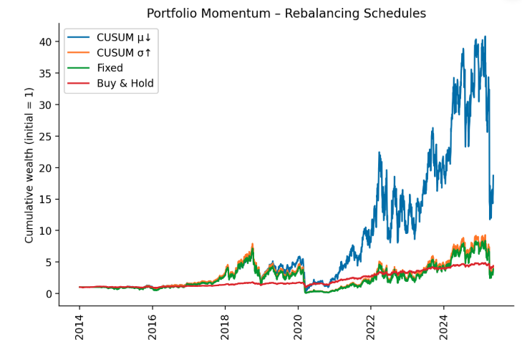
“Time in the market beats timing the market?”
Notes:
Default remove intel

Slide 8
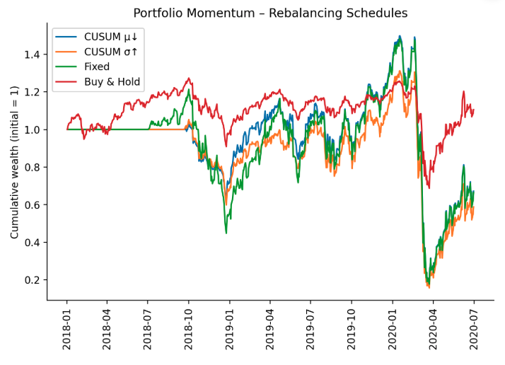
“Time in the market beats timing the market?”
Notes:
Restrict 2018-2020

Slide 9
Many applications
Continuous monitoring of patient vitals and blood glucose
Manufacturing and quality control
Chemical processes
Network performance (traffic and latency)
Notes:
Stocks were just an easy example, but this framework can be useful for many applications

Slide 10
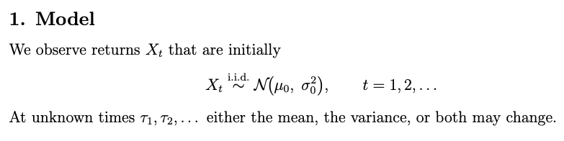
Data Generating Mechanism
In simulations, T₁, T₂ , … ~ Geometric(p).
Notes:
So how can we do that? Let me set up the problem

Slide 11
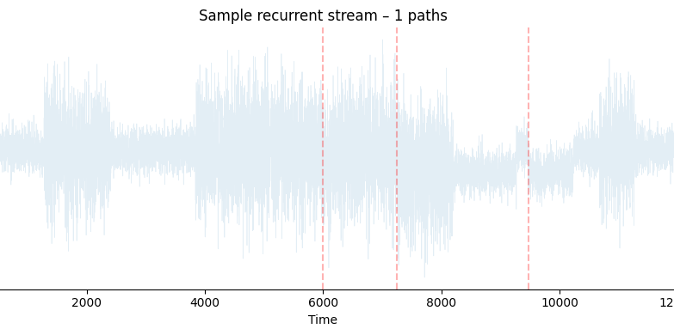
Downwards mean shifts

Slide 12

Downwards mean shifts
All variance shifts

Slide 13

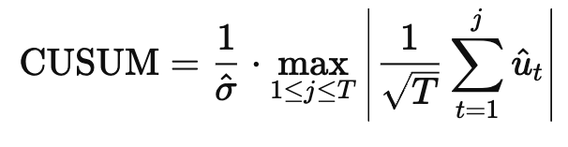
CUSUM Statistic – offline detection
Ewan Stafford Page (1954) – “Continuous Inspection Schemes,” Biometrika 41:100-115.
Assume you observe a time series 𝑦_{t}, for 𝑡 = 1 , 2 , . . . , T : 𝑦_{t} = 𝜇 + 𝑢_{t} ​
μ is a constant mean under the null hypothesis (no structural break),
𝑢_{t} is a stationary, mean-zero error process.
Residuals:
Compare CUSUM to critical value from Brownian bridge.
Notes:
Offline framework. Y_bar is the problem that prevents this from being online.

Slide 14
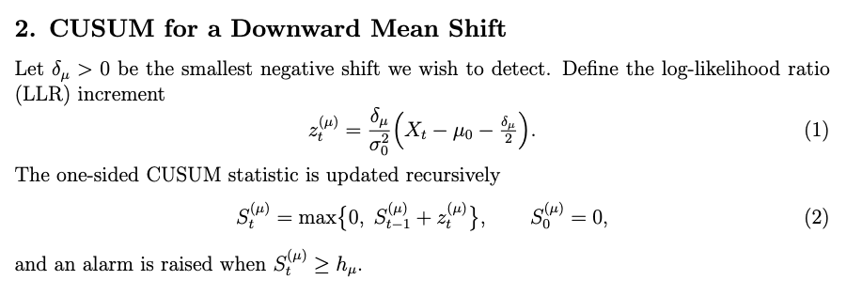
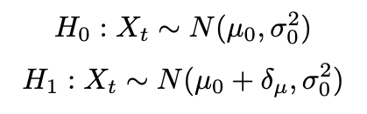
CUSUM Statistic – online detection Page (1954) – “Continuous Inspection Schemes,” Biometrika 41:100-115.
Log-likelihood ratio increment:
^ µ₁
Notes:
Unlike with offline, we need to choose h_mu. Lucas & Crosier 1982 created a table of optimal h_mu.

Slide 15
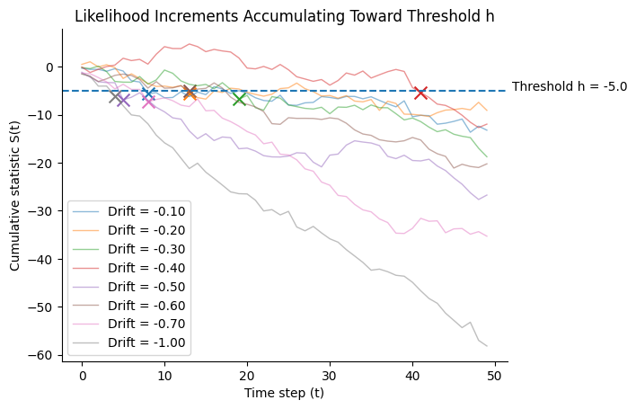
Example: Drifted random walk accumulations trigger the alarm
Notes:
• “Each increment ≈ log-likelihood ratio under ‘shifted’ vs ‘in-control’. When the real drift is –0.30 the walk hits h=−5h=-5h=−5 in 25 steps; with –0.05 drift it may never cross.”

Slide 16
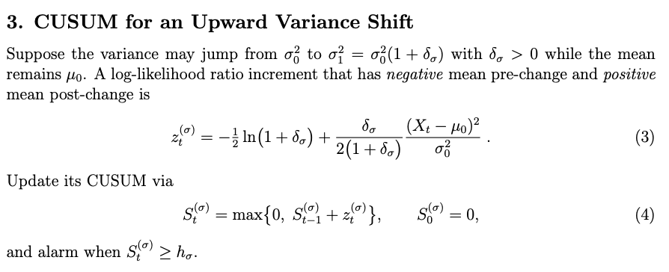
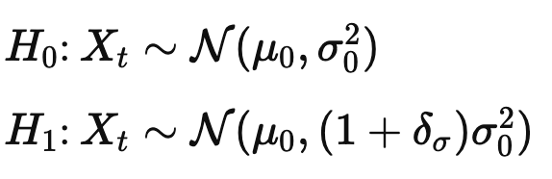
CUSUM Statistic
Log-likelihood ratio increment:
^ σ₁²
Notes:
So how can we do that? Let me set up the problem

Slide 17
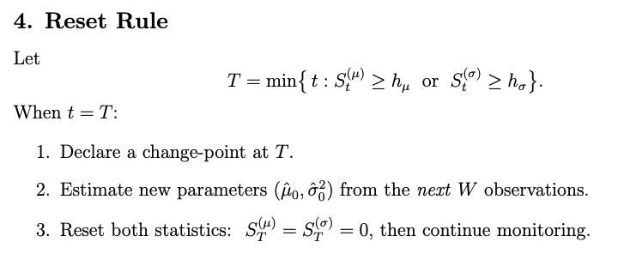
Resettable CUSUM Statistic
Data generating process
Notes:
So how can we do that? Let me set up the problem

Slide 18
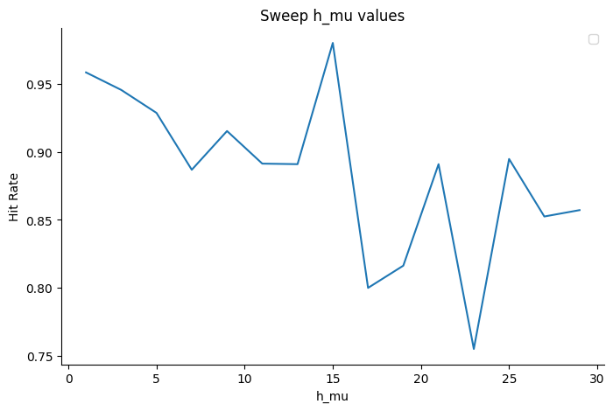
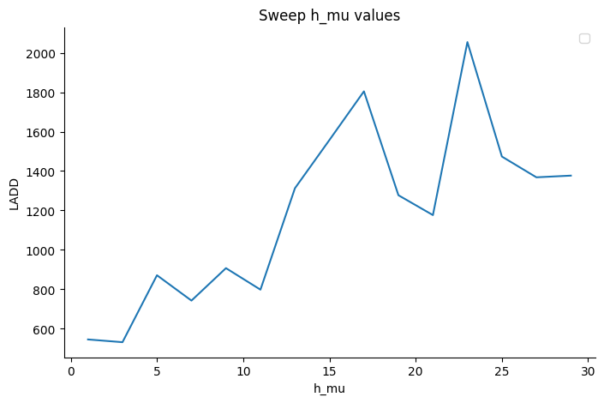
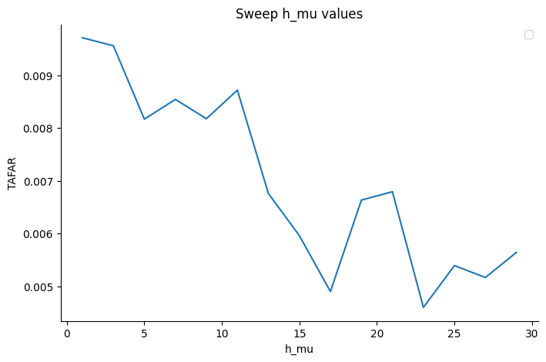
Optimal h_{µ}? Lucas & Crosier 1982 created a Monte-Carlo table of optimal h_{µ}. Ultimately it depends on what you care about: (i) shift, (ii) tolerable false alarm rate, etc.

Slide 19
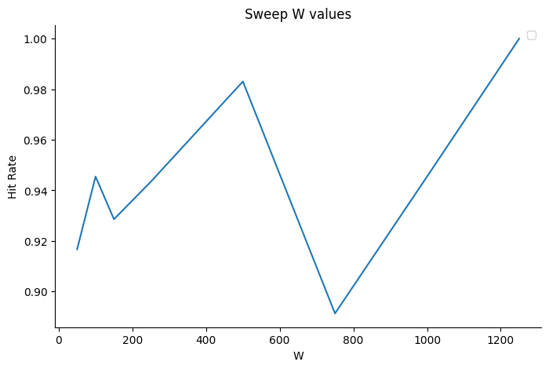
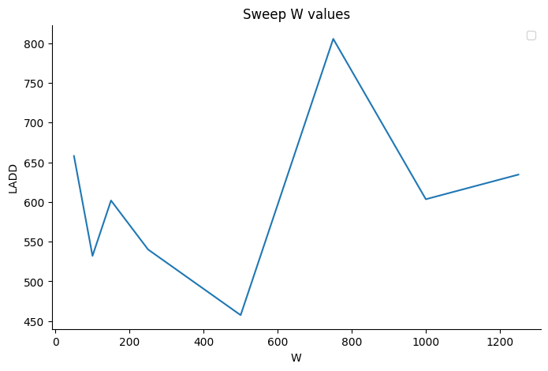
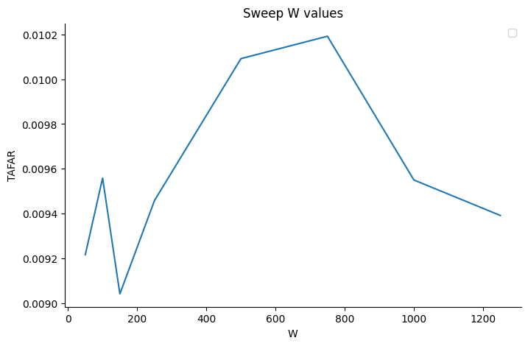
Optimal W?

Slide 20
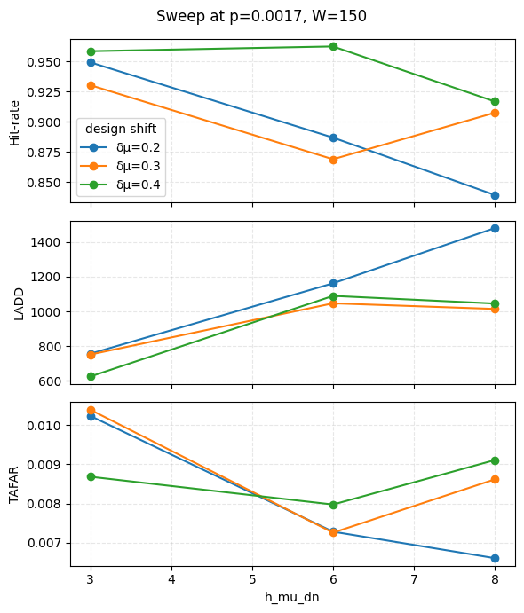
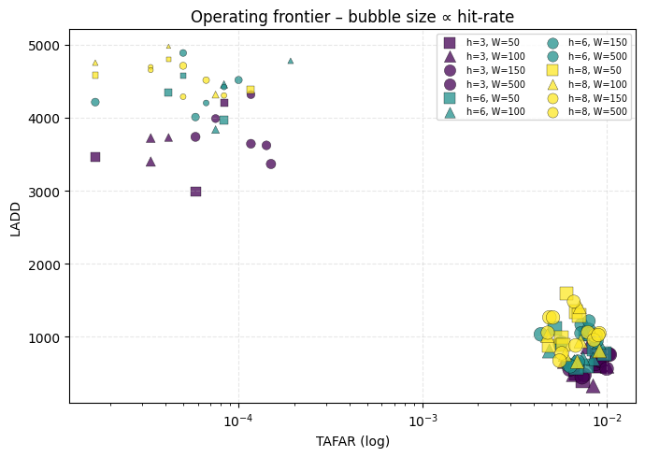
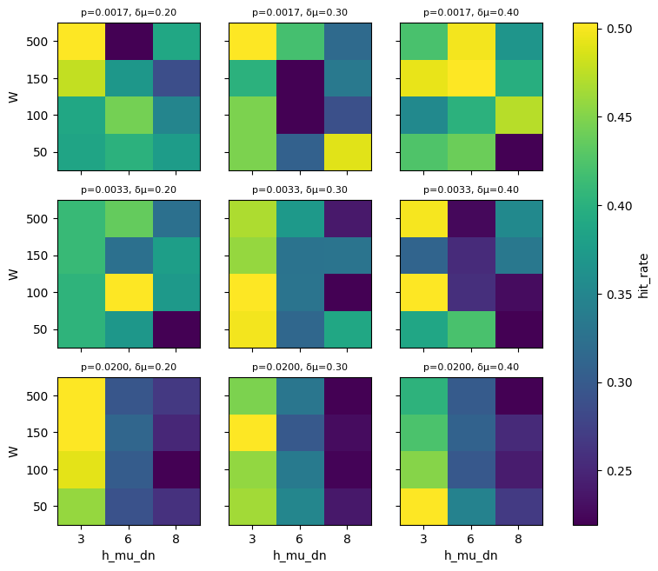
Simulations to find optimal parameters

Slide 21
Non-monotonic power for mean shifts
Ciprian M. Crainiceanu & Timothy J. Vogelsang (2007) Nonmonotonic power for tests of a mean shift in a time series , Journal of Statistical Computation and Simulation, 77:6, 457-476, DOI: 10.1080/10629360600569394
When δ = µ₁-µ₀increases above a threshold, we start to lose power.
The variance estimator inflates as δ→∞, driving test statistics down.
Streamlit app settings: µ₁ = (-1,-2,-10,-100,-1000)

Slide 22
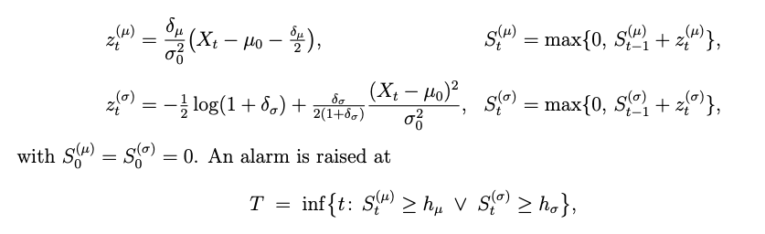
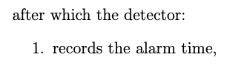
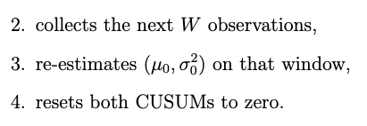
Resettable Sequential Detector Summary
Data generating process
Ciprian paper
Show dashboard
Conclusins from dashboard experiments
Garch problem
Notes:
So how can we do that? Let me set up the problem

Slide 23
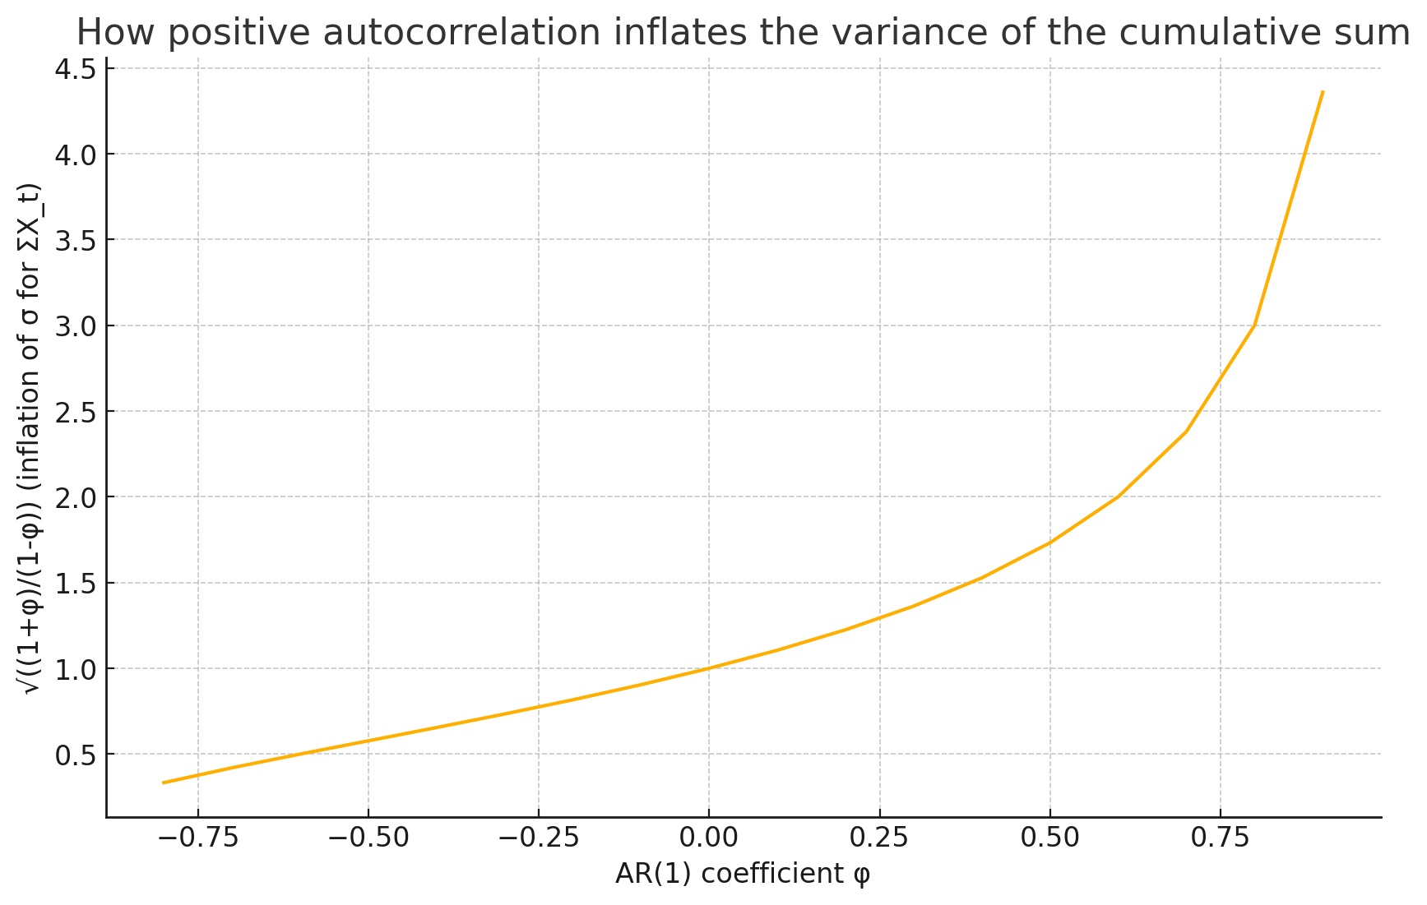
Autocorrelated data
Notes:
So how can we do that? Let me set up the problem

Slide 24
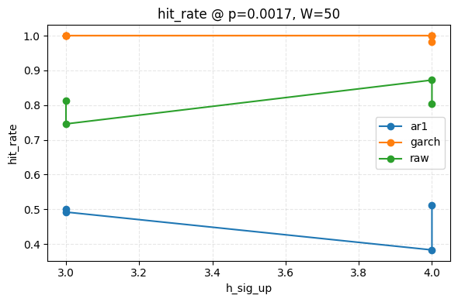
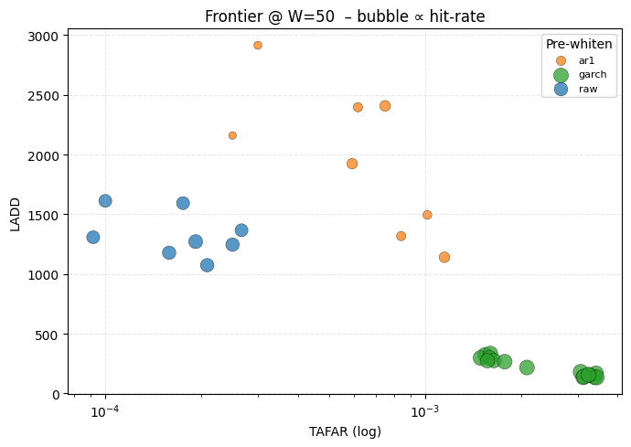
Pre-whitening
A key assumption is that the data is iid → rarely true in practice → pre-whiten with AR(1), GARCH(1,1), student-t, etc.
GARCH pre-whitening increases alarm sensitivity in every case
For shifts in mean
For shifts in variance
When the data is truly heteroskedastic
Also when GARCH is mis-specified
Caveats: false alarms. Sometimes OK in practice?
Notes:
Why it boosts σ-detection in practice (even though σ is rescaled to 1)
Your synthetic generator makes abrupt variance jumps. After a jump, the GARCH recursion still relies on pre-jump parameters for a few steps, so the first post-jump residuals are under-scaled: εt=(Xt−μ^t)/σ^t≈( N(0, σ12) )/σ0ε_t = (X_t-\hat\mu_t)/\hat\sigma_t ≈ (\,\mathcal N(0,\,\sigma_1^2)\,)/\sigma_0εt​=(Xt​−μ^​t​)/σ^t​≈(N(0,σ12​))/σ0​.
Those εₜ spikes (kurtosis) are exactly what a σ-CUSUM counts, so you get faster hits and fewer false alarms from routine volatility clustering.
Real data often show the same pattern: an earnings-day jump or a glucose shock produces residual outliers before the GARCH filter adapts, and those outliers trip the σ branch cleanly.

Slide 25
Caveats with stock model
No holding cash
Parameter fragility (large swings in hit-rate and PnL when we modify parameters)
Works in a bull market but doesn’t work in bear market (e.g. after Covid (2023), phone stocks went down then industrials followed. If we detected the downward trend from )
Cost model = linear, no slippage / bid-ask (real execution has spread-crossing, delay, and market impact)
Notes:
🚀 Low-hanging improvements
Risk-weighted momentum – weight the winners by inverse 20-day vol to dampen single-stock blow-ups.
Dual CUSUM – combine μ↓ and σ↑ alarms: derisk on either, but only rerisk when both drift back to baseline.
Adaptive threshold – tie h to rolling realized vol so the detector isn’t too jumpy in quiet markets or too sluggish in turbulent ones.
Execution layer – plug in a simple spread + fixed fee model; see how the strategy degrades at 5 bps vs 20 bps.
Walk-forward validation – optimise parameters on 2014-19, apply unchanged to 2020-24, then rotate. Shows whether the edge persists.
Use the Simulation tab to visualise detector trade-offs first, then push promising parameter sets into the Portfolio tab for a full cost-aware back-test.

Slide 26
Open questions in this field?
Optimal warmup W*: derive closed-form (or asymptotic) minimiser of long-run risk Risk ( 𝑊 ) = LADD ( 𝑊 ) + 𝜆 TAFAR ( 𝑊 )
Formalize misspecified-GARCH’s effect on power
Multivariate returns
Score-GLR detector with time-varying volatility. Replace ad-hoc μ/σ CUSUM by one statistic
Extends Hörmann & McTaggart (2024) from “one break” to restart setting

Slide 27
Thank you for listening!

